Slide 1




GreenMinds Industries
Streamlining Travel Approval Process
Using Microsoft Power Automate

Slide 2


Overview
Introduction
03
Problems
04
Solutions
05
Objectives
06
Travel Approval Process
07
Statistics
12
Application Demo
13
Our Team
14

Slide 3

Introduction
The Entire Travel Approval Process is streamlined to address inefficiencies within the organization. It was developed using Microsoft Power Automate to address the challenge of managing travel requests efficiently. This presentation outlines the request approval process and the value it brings by automating the travel approval workflow. Its implementation significantly improves operational efficiency, making it meaningful and relevant to modern business processes.

Slide 4

Problems
The current travel approval process within the organization is inefficient and manual, leading to delays, miscommunication, and a lack of transparency. Employees from different departments submit travel requests, which require dual approval before final confirmation. The manual process results in:
Delayed responses.
Difficulty tracking approval status.
No centralized system for documentation.

Slide 5

How can we streamline the travel request and approval process to reduce the administrative burden and improve efficiency?
Solution
To address the inefficiencies, a Power Automate-based workflow automates the entire travel approval process. This ensures timely approvals, centralized communication, and real-time visibility.

Slide 6



Objectives
Improved Communication
Enhance Approval Efficiency
Transparency
Notifications ensure all stakeholders are informed.
Ensure faster approvals with automated notifications and task assignments.
Real-time updates visible in Outlook and Teams.

Slide 7
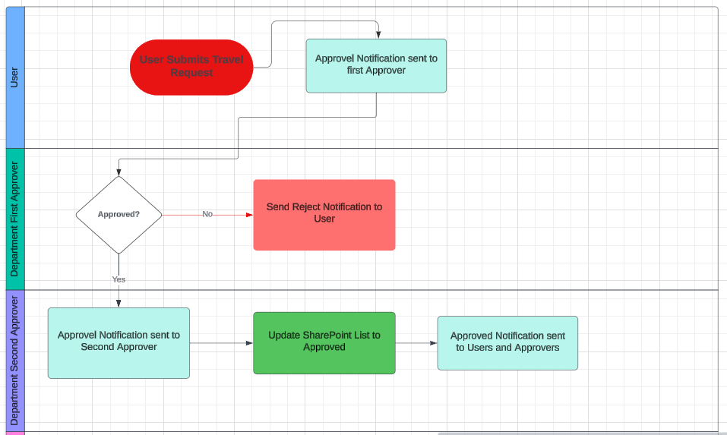
Travel Approval Process
The Workflow:
1. A travel request is created.
2. The request is automatically sent to two approvers.
3. If both approvers approve, the request is marked as "Approved."
4. If any approver rejects, the request is marked as "Rejected."
5. Notifications are sent to the requester and the approvers at every stage.
6. Approval tracking is visible in Outlook and Teams.

Slide 8
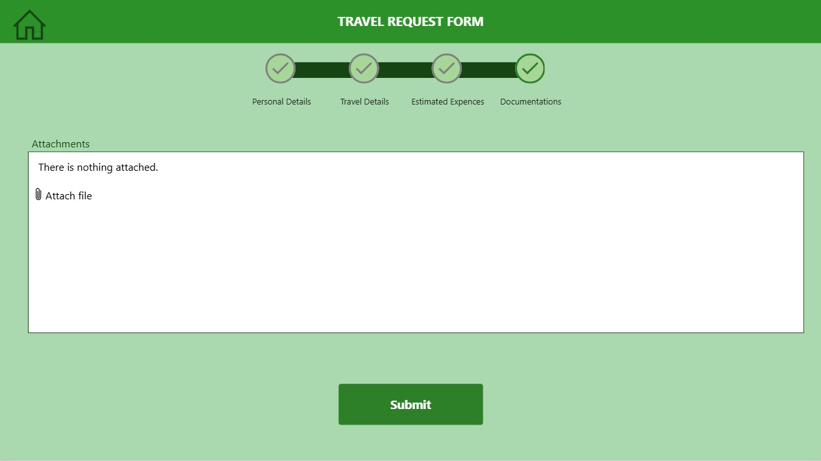

1
Submitting the form will trigger the flow.

Slide 9
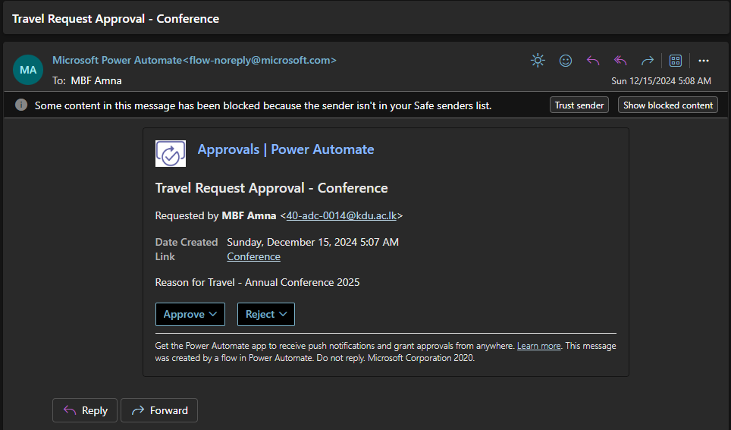
2
User Admins of the specific department will be notified.

Slide 10
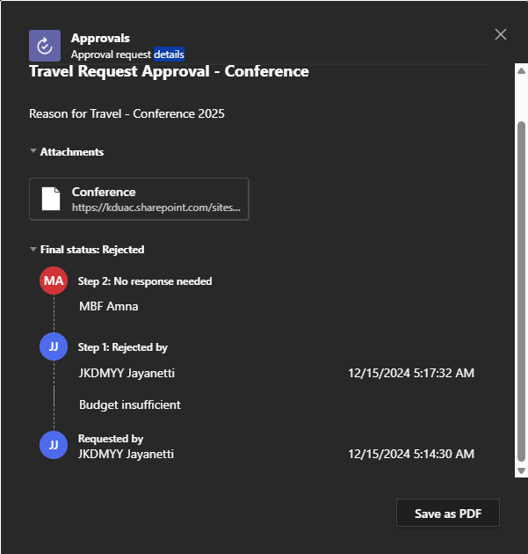
3
Approval Process can be viewed in Teams.

Slide 11
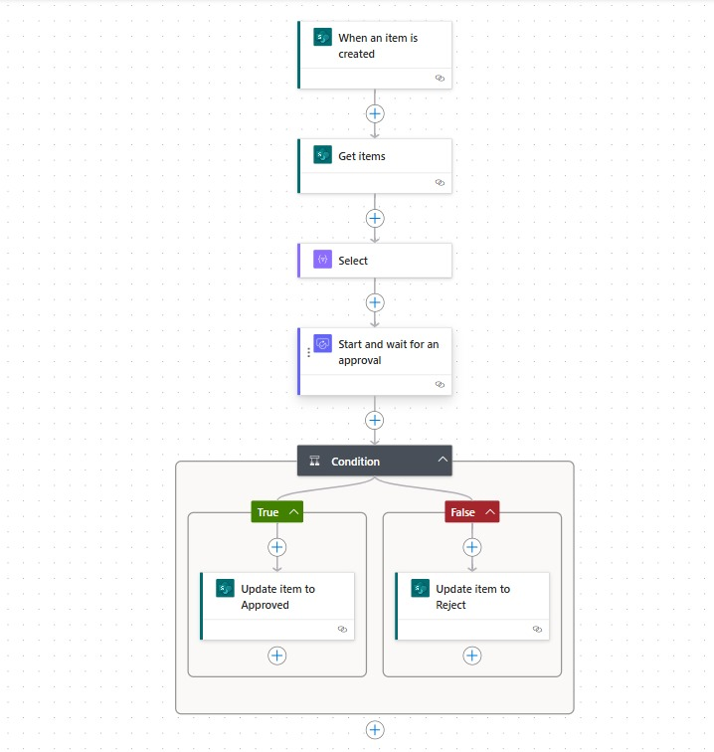
Overall Automation Process.

Slide 12
Statistics
80%
-10%
Time Saved with App Integration
Average Approval Time
20%
75%
Growth of Total Number of Requests
Employee Satisfaction

Slide 13
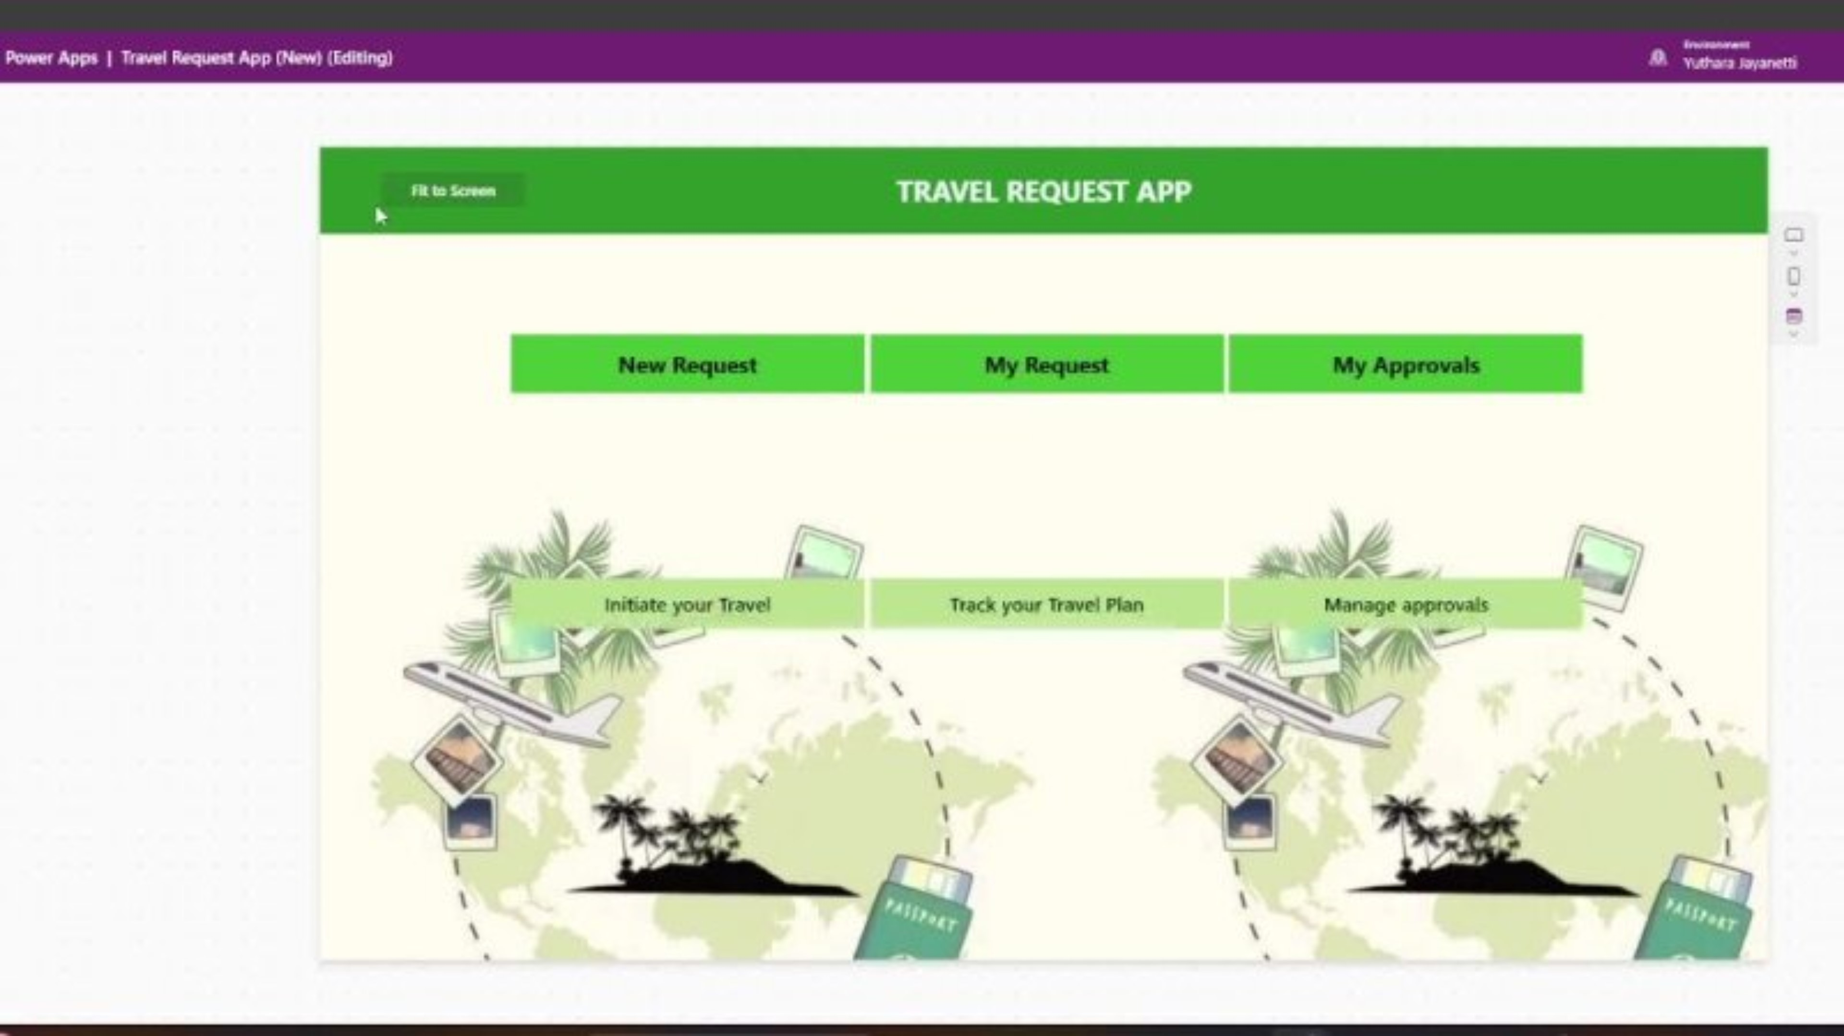
Streamlining Travel Approval Process
- Demo -

Slide 14




OUR TEAM
JKDMYY Jayanetti D/ADC/23/0023
MBF Amna D/ADC/23/0014
HTSH Samadhi D/ADC/23/0006
KGT Randika D/ADC/23/0024

Slide 15


GreenMinds
THANK YOU!

